Slide 1
Arduino Bluetooth Setup
2014 Spring
By Peng Li

Slide 2
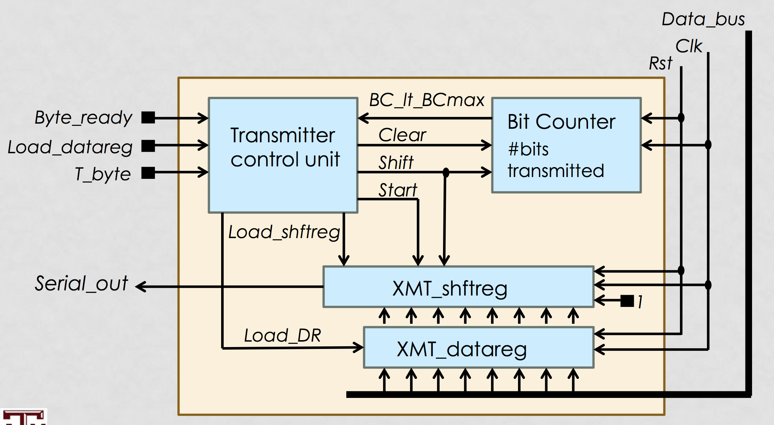
Universal asynchronous
receiver/transmitter (UART)
Picture From ECEN 468 Lecture by Dr. Hu, Jiang

Slide 3
Bible- James 1:19 (ESV)
19 Know this, my beloved brothers:
let every person quick to hear(Parallel input ), slow to speak (Serial output), slow to anger(Parity bit) ;

Slide 4
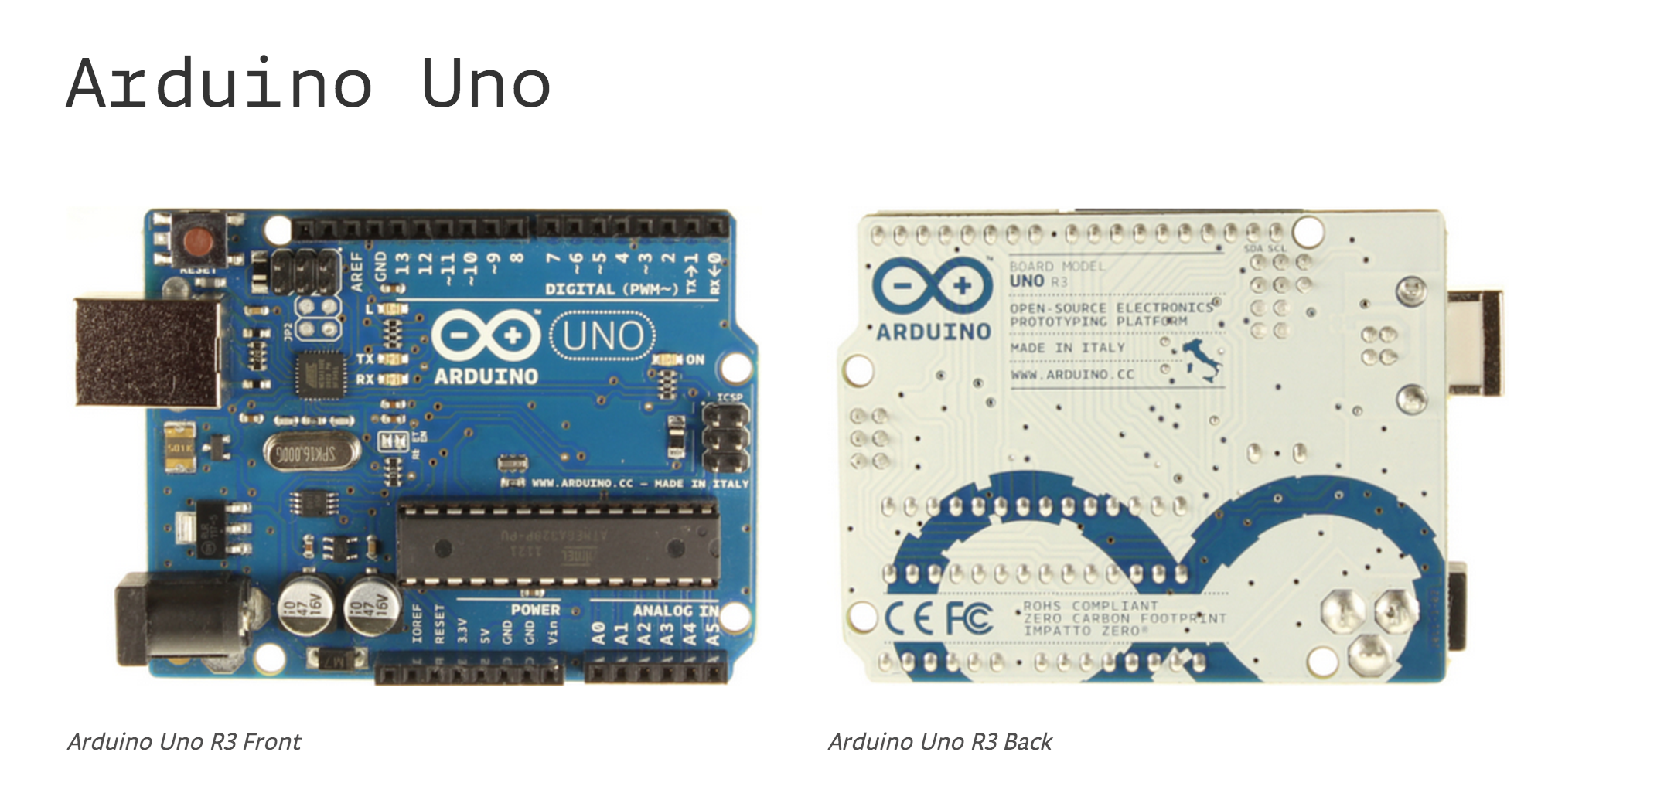
Microcontroller ATmega328
Operating Voltage 5V
Input Voltage (recommended) 7-12V
Analog Input Pins 6
Flash Memory 32 KB (ATmega328) of which 0.5 KB used by bootloader
SRAM 2 KB (ATmega328) (Power dependent)
EEPROM 1 KB (ATmega328) (Power independent)
Clock Speed 16 MHz

Slide 5
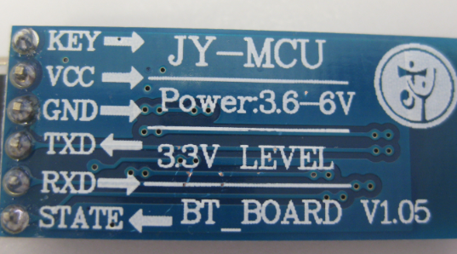
JY - MCU

Slide 6
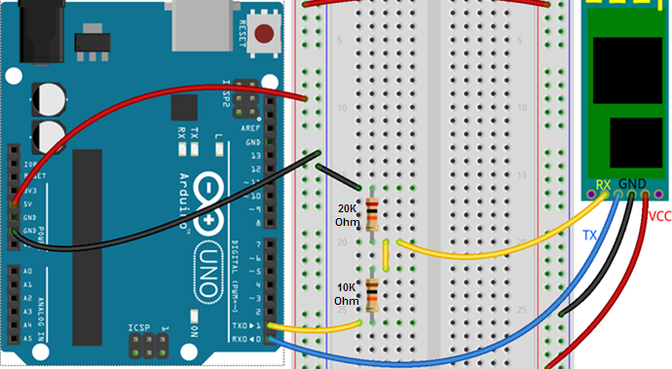
Connection

Slide 7
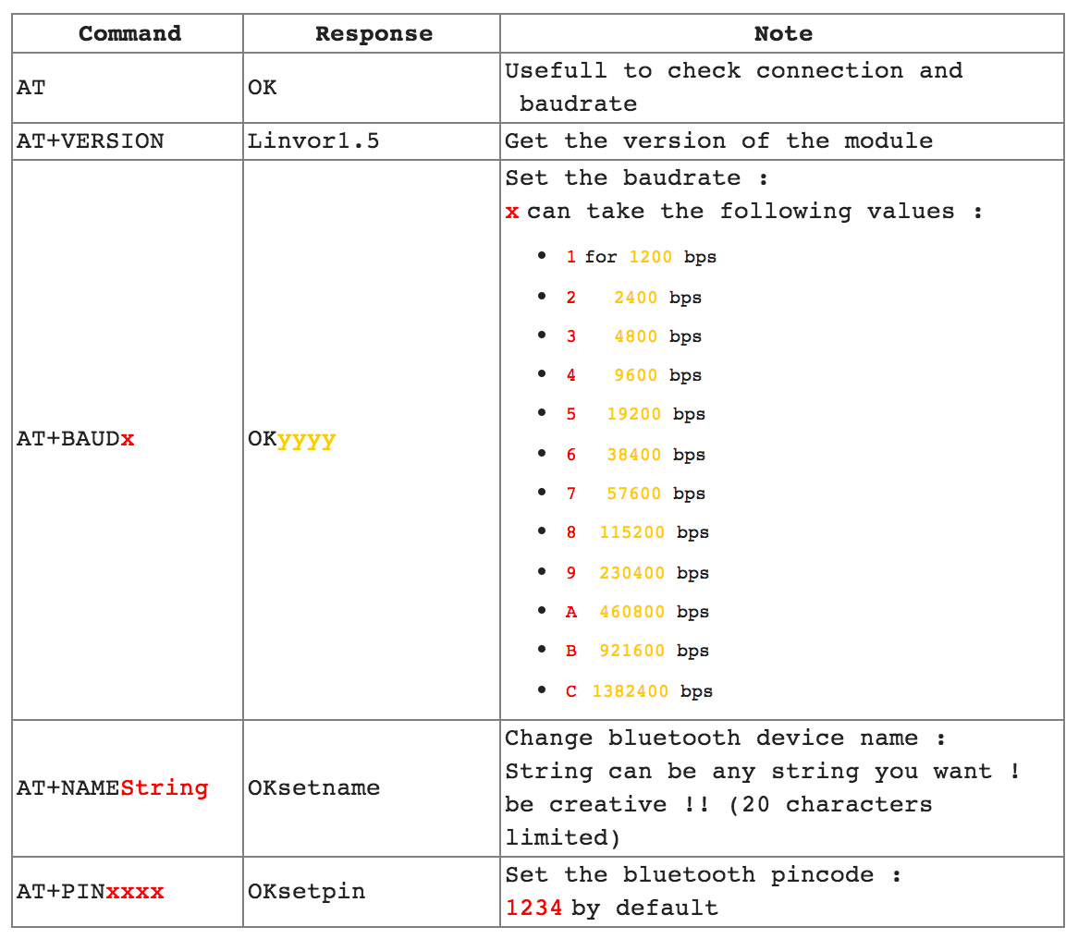

Slide 8
Questions ?

